Slide 1
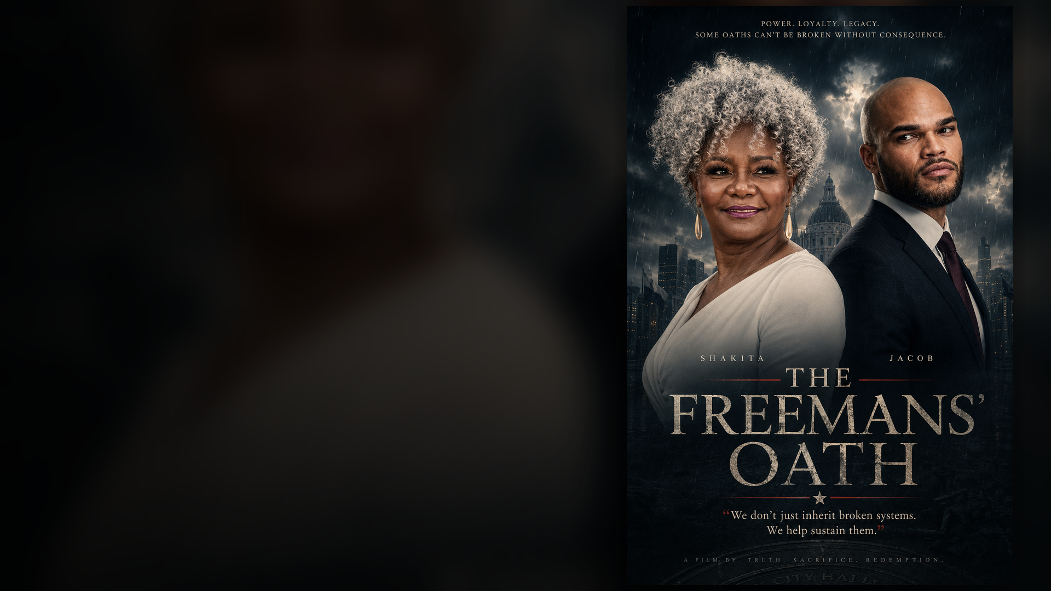
CONTACT: Jeff Lambert Wingfield
www.j-wingfield.com
Wingfieldj@montclair.edu | Wingfieldjef@aol.com
(973) 655-0154
FUNDRAISING PITCH DECK
THE FREEMANS'
OATH - Feature Film
I would welcome the opportunity to discuss how you might join us as a producing partner and help bring THE FREEMANS’ OATH to the screen.
Contact me for detailed budget breakdown and script.
Jeff Lambert Wingfield
www.j-wingfield.com
Wingfieldj@montclair.edu | Wingfieldjef@gmail.com
(973) 655-0154
$87,000 budget ceiling
THE FREEMANS' OATH
INTRO
Notes:
Cover slide introduces the large-text, ADA-friendly fundraising deck and states the $87,000 budget ceiling.
Accessibility note: Deck text is live/editable PowerPoint text. Body copy is designed at 16 pt or larger where practical.

Slide 2
FUNDRAISING PITCH DECK
THE FREEMANS'
OATH Feature Film
Starring Ethan Edward Metz
Featuring Tony Award Winner and Emmy Nominee Tonya Pinkins
Jacob Freeman, a man corrupted by ambition and the sins of his father, must confront the very power structures he once embraced. With the truth threatening to destroy him, he faces a choice: expose the corruption or be consumed by it. In the face of betrayal, redemption lies in the hands of those who choose to fight for the truth.
$87,000 budget ceiling
THE FREEMANS' OATH
01
Notes:
Cover slide introduces the large-text, ADA-friendly fundraising deck and states the $87,000 budget ceiling.
Accessibility note: Deck text is live/editable PowerPoint text. Body copy is designed at 16 pt or larger where practical.

Slide 3
INVESTMENT CASE
A contained film with a feature-scale spine.
The ask is disciplined: raise the exact money required to execute the 11-day production plan, protect the performances, and finish the film for festival, sales, civic/community, and partner screening opportunities.
$87K
11
23
single production ceiling
shoot days
cast + crew positions
Target Audience:
• Genre: Crime Drama / Political Thriller / Supernatural
• Demographic: Adults 18-75, with a focus on viewers who enjoy morally complex characters, suspenseful storytelling, and high-stakes drama. Fans of shows like House of Cards, Breaking Bad, and films like The Godfather and Nightcrawler would resonate with the moral and political themes.
THE FREEMANS' OATH
02
Notes:
The investment case emphasizes disciplined financing, the $87K ceiling, an 11-day shoot, and a lean cast and crew model.
Accessibility note: Deck text is live/editable PowerPoint text. Body copy is designed at 16 pt or larger where practical.

Slide 4
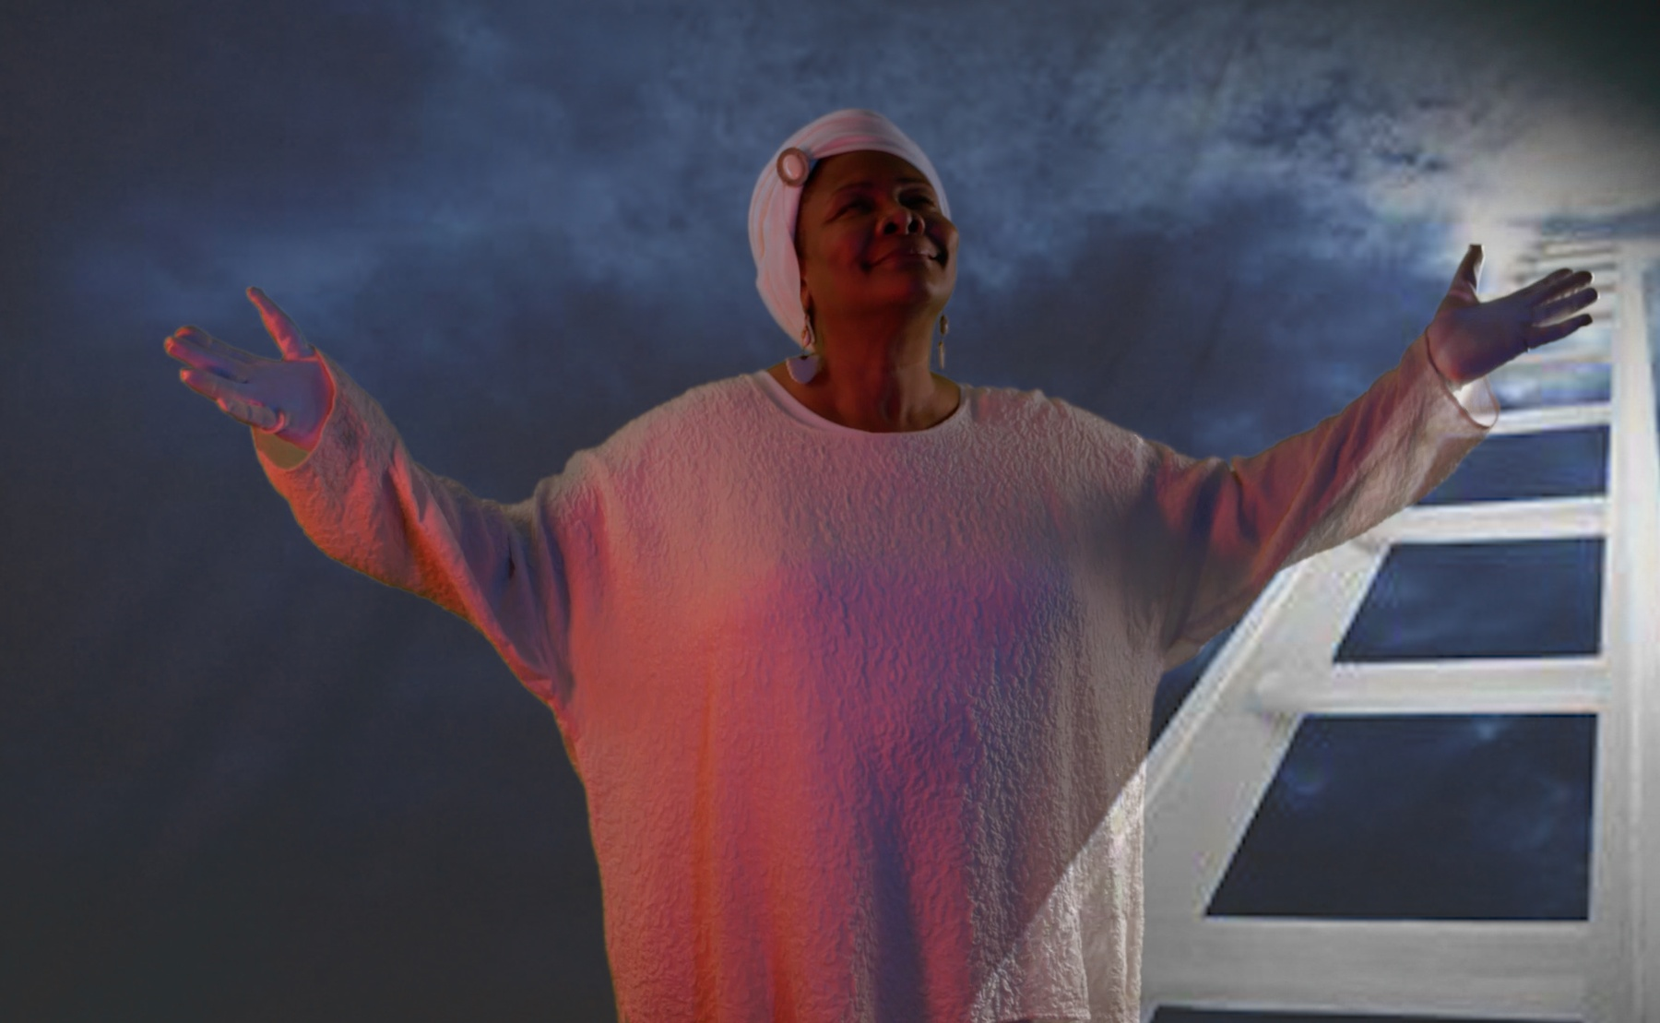
STORY + POSITIONING
Power is inherited.
Conscience is earned.
Themes:
1. Redemption & Guilt: The internal struggle of Jacob Freeman to reconcile his past actions and seek redemption for his father's sins, even if it costs him everything.
2. Power & Corruption: The corruptive nature of political power, and how it twists relationships and identities.
3. Betrayal & Loyalty: The betrayal Jacob faces from those he once trusted, and the loyalty of those who still stand by him.
4. The Fight for Truth: The ultimate battle between truth and lies, and the personal cost of unveiling the truth.
Jacob Freeman is one deal away from the office he was raised to want. To win, he must decide whether to honor his father's legacy or bury the truth beneath blood, ballots, and a body count.
THE FREEMANS' OATH
03
Notes:
Story slide positions the film as a political morality thriller with clear audience lanes.
Accessibility note: Deck text is live/editable PowerPoint text. Body copy is designed at 16 pt or larger where practical.

Slide 5
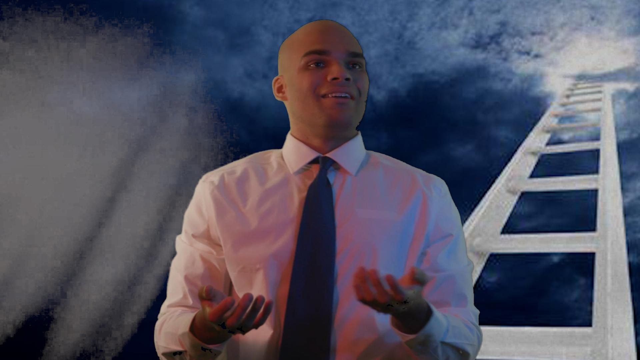
STORY + POSITIONING
Power is inherited.
Conscience is earned.
Key Selling Points:
1. A Complex Protagonist: Jacob Freeman’s transformation from an ambitious, morally grey figure to a man seeking redemption offers a compelling character arc that will resonate with viewers who appreciate nuanced storytelling.
2. High-Stakes Drama: The story’s intense confrontations, power struggles, and moments of moral decision-making make for an edge-of-your-seat viewing experience.
3. Supernatural Twist: The introduction of Shakita and her otherworldly influence adds a unique and unpredictable element, giving the story a supernatural edge that will surprise and intrigue viewers.
4. Timely Themes: The exploration of power, corruption, and redemption in a political context feels highly relevant to contemporary discussions about integrity, accountability, and the consequences of one’s actions.
THE FREEMANS' OATH
03
Notes:
Story slide positions the film as a political morality thriller with clear audience lanes.
Accessibility note: Deck text is live/editable PowerPoint text. Body copy is designed at 16 pt or larger where practical.

Slide 6
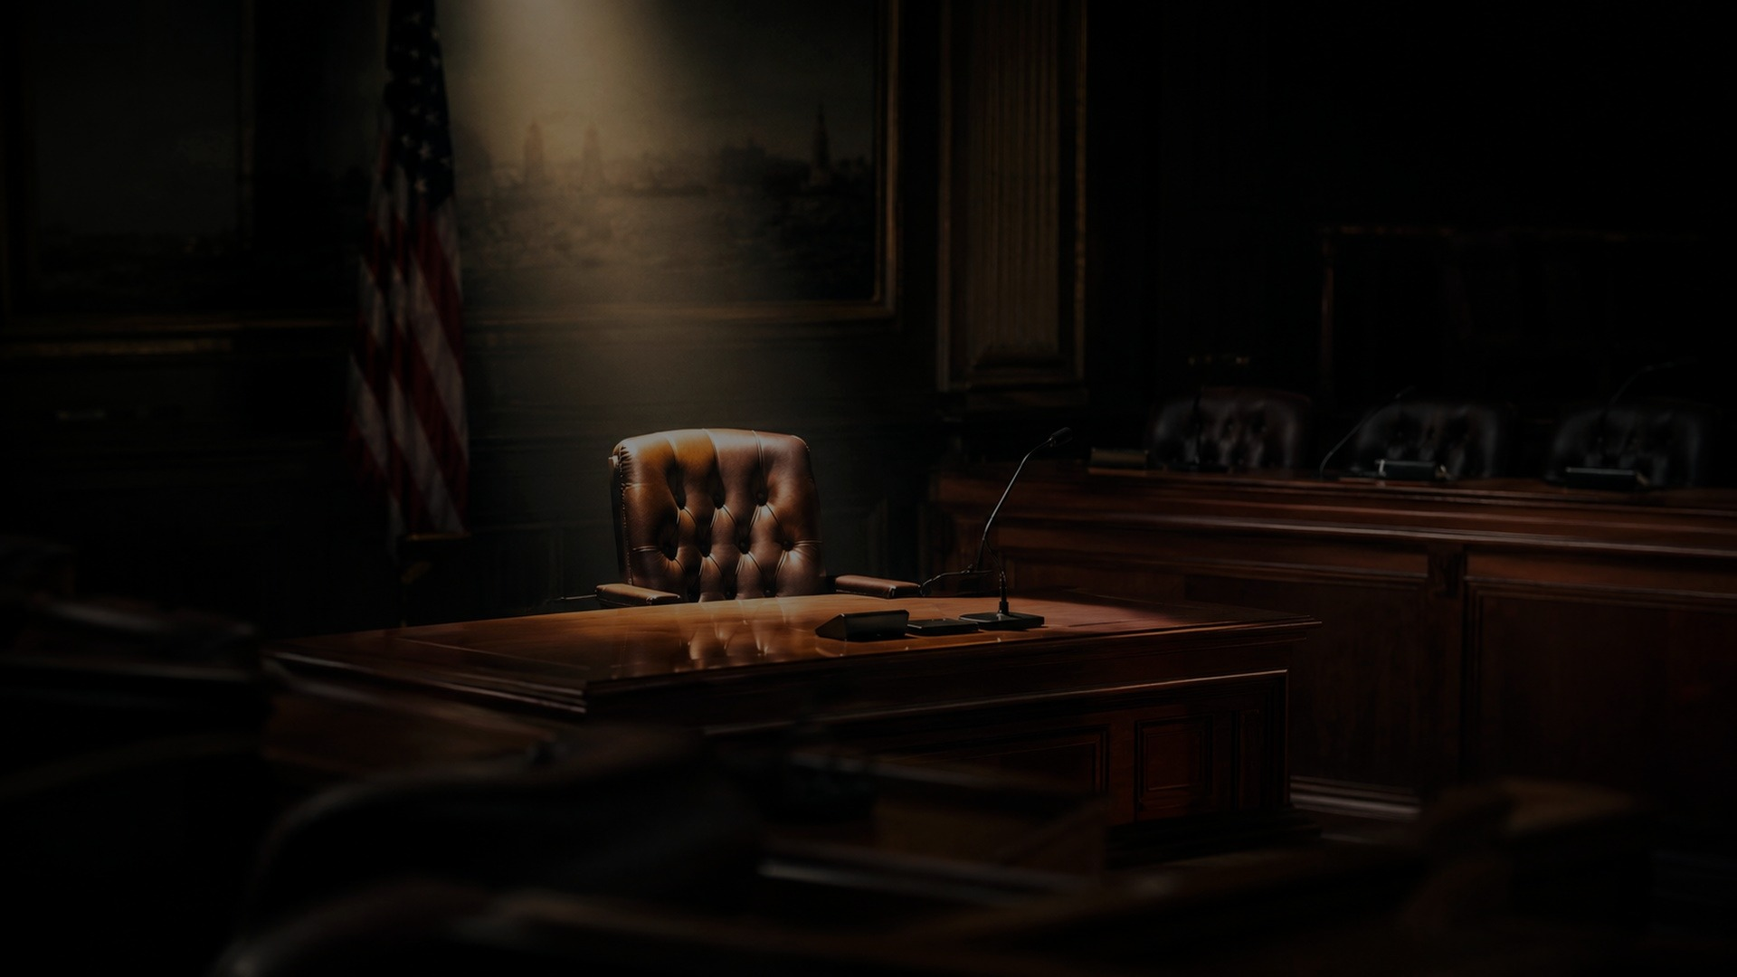
DIRECTOR'S STATEMENT
The old sin always finds the son.
The Freemans' Oath is not about a politician with a problem. It is about inheritance: what a son owes his father, what a leader owes his community, and what a man owes his own soul.
The audience should feel trapped between ambition and conscience. When Jacob chooses, the choice must cost him something.
Closing Statement:
"The Freeman Oath: Redemption's Edge" is a gripping continuation of a story about power, corruption, and the soul-crushing cost of ambition. It’s a journey through darkness and redemption, where the true measure of a man lies not in his ability to wield power, but in his courage to face the consequences of his choices. With a stellar cast of characters and a narrative that keeps audiences on the edge of their seats, this is a story you won't want to miss.
That is drama - the old kind, the kind that still works.
THE FREEMANS' OATH
04
Notes:
Director statement focuses on inheritance, public duty, family legacy, conscience, and dramatic cost.
Accessibility note: Deck text is live/editable PowerPoint text. Body copy is designed at 16 pt or larger where practical.

Slide 7
DIRECTOR VISUAL APPROACH
Campaign offices as confessionals.
The film should feel theatrical without becoming stage-bound. The camera gives the speeches weight, but the edits and the supernatural/expressionist elements will keep the danger breathing down the audience's neck.
Image language:
Low-key light, warm interiors, civic shadows, visual effects, pressure in the frame.
Performance language:
Dialogue-driven scenes with moral stakes, wit, sound effects, and no easy absolution.
Production language;
Contained locations, controlled company moves, schedule discipline.
Creative promise: suspense and moral consequence, not speeches wearing a rented tuxedo.
THE FREEMANS' OATH
05
Notes:
This slide breaks the director statement into visual, performance, and production language.
Accessibility note: Deck text is live/editable PowerPoint text. Body copy is designed at 16 pt or larger where practical.

Slide 8
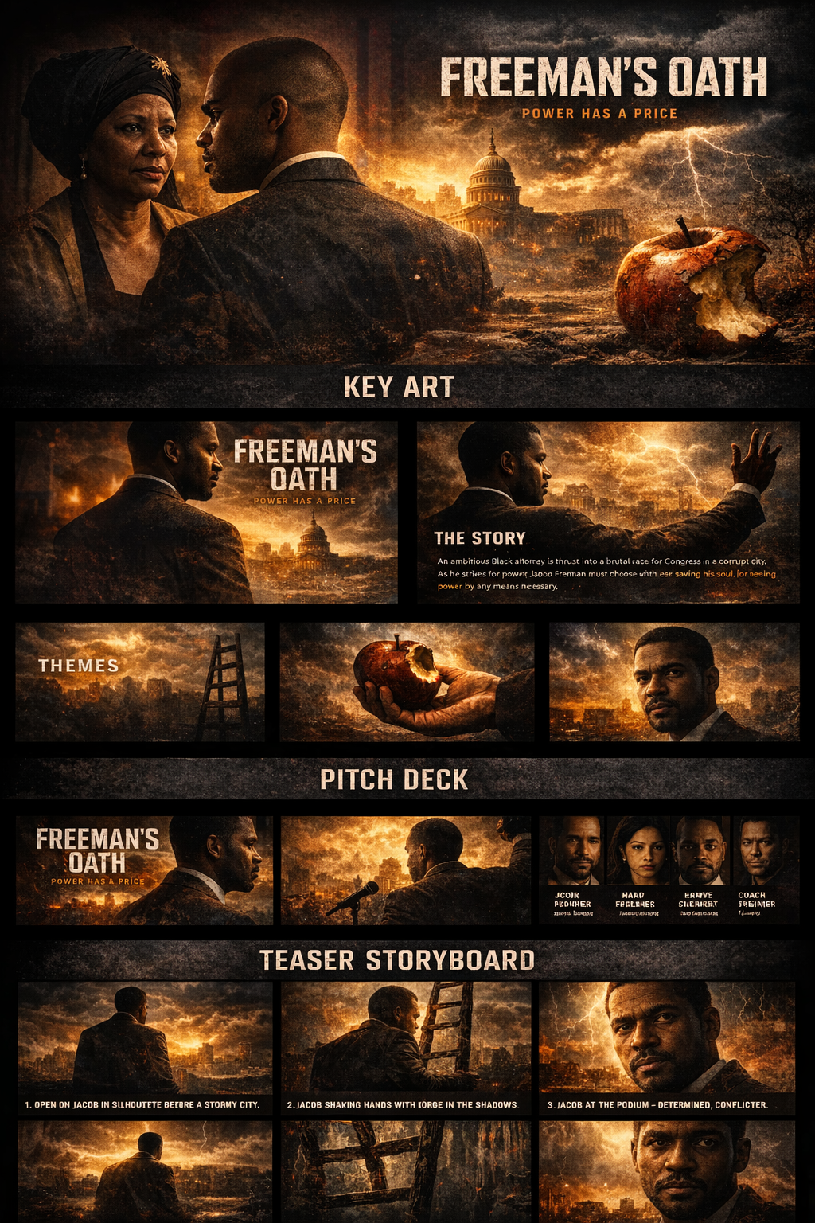
PROOF-OF-CONCEPT STRENGHT: THE PACKAGE
The package is already walking into the room.
Visual Style:
• Atmosphere: The visuals in "The Freeman Oath" are moody and dark, with high-contrast lighting that reflects Jacob’s internal struggle. The storm outside serves as a constant reminder of the chaos, both in the world and in his soul. The use of flickering lights, dark alleyways, and shadowy figures creates an air of suspense and danger.
• Symbolism: Mirrors, reflections, and shadows are recurrent motifs, symbolizing Jacob’s fractured identity and the moral dilemmas he faces. The light and dark contrasts represent the constant battle between corruption and redemption.
• Supernatural Elements: Shakira's intervention introduces an ethereal quality to the story, with light and wind becoming tangible forces that represent spiritual clarity, mystical, and magical, but resolute.
Preliminary shots of Tonya Pinkins as SHAKITA and Ethan Edwards Metz as JACOB above in a proposed short version proves tone and talent for the execution of a Full-length film.
THE FREEMANS' OATH
06
Notes:
Proof slide highlights the existing short or project assets as evidence for the fundraising package.
Accessibility note: Deck text is live/editable PowerPoint text. Body copy is designed at 16 pt or larger where practical.

Slide 9
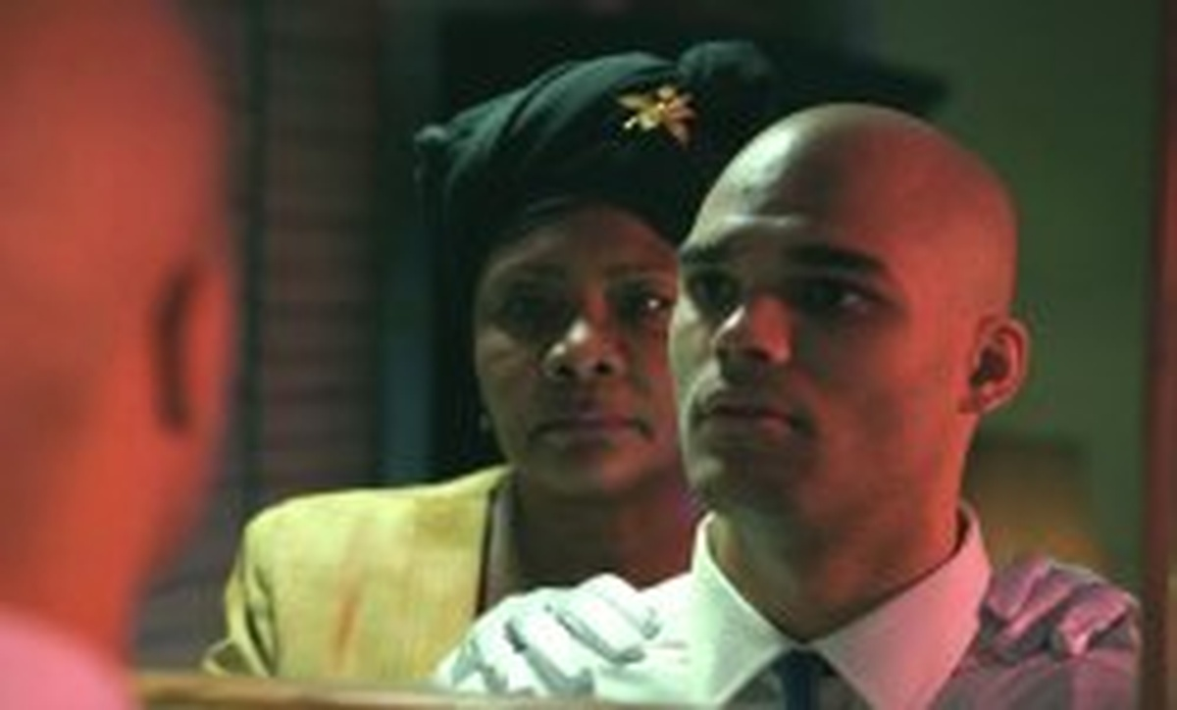
PROOF-OF-CONCEPT STRENGHT: THE PACKAGE
The package is already walking into the room.
Proof-of-concept strength:
- Political urgency
- Performance-driven scenes
- Contained production model
- Civic, community, and College campus conversation value
- Film Feature expansion
- Genre: Crime Drama / Political Thriller / Supernatural / Expressionism
- Demographic: Adults 18-45, with a focus on viewers who enjoy morally complex characters, suspenseful storytelling, and high-stakes drama. Fans of shows like House of Cards, Breaking Bad, and films like The Godfather and Nightcrawler would resonate with the moral and political themes.
Preliminary shots of Tonya Pinkins as SHAKITA and Ethan Edwards Metz as JACOB above in a proposed short version proves tone and talent for the execution of a Full-length film.
THE FREEMANS' OATH
06
Notes:
Proof slide highlights the existing short or project assets as evidence for the fundraising package.
Accessibility note: Deck text is live/editable PowerPoint text. Body copy is designed at 16 pt or larger where practical.

Slide 10
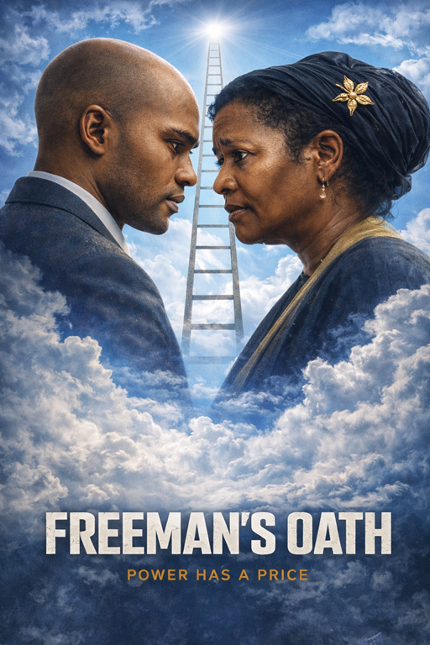
PROOF-OF-CONCEPT STRENGHT: THE PACKAGE
The package is already walking into the room.
SCALABILTY:
Designed to expand into:
Feature Film, Limited Series, and Streaming Distribution
- The camera will move between naturalistic and stylized—tight close-ups on emotional tension, wide frames for ghostly isolation, and dynamic lighting to reflect internal collapse. Sound will build psychological unease: heartbeats, echoes, static. The supernatural is suggested, never explicit. Faith and fear coexist.
THE FREEMANS' OATH
06
Notes:
Proof slide highlights the existing short or project assets as evidence for the fundraising package.
Accessibility note: Deck text is live/editable PowerPoint text. Body copy is designed at 16 pt or larger where practical.

Slide 11
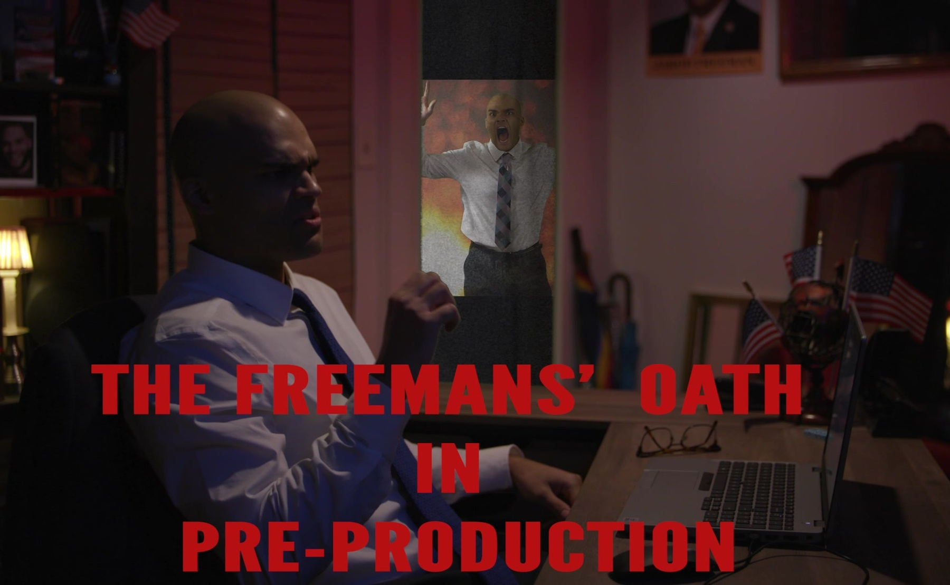
CORPORATE PARTNERSHIP STRATEGY
Partners underwrite the conversation…
The partnership lane is strongest when it matches what the film is already about:
Civic and community leadership
Ethics
Legacy
Education
Community trust
6. Community Engagement
Clip above: Ethan Edward Metz (JACOB) and Tonya Pinkins (SHAKITA)
Partner promise: A sponsor is not buying wallpaper for the credits. They are buying presence in a hard, necessary conversation - and a seat in the room when it happens.
THE FREEMANS' OATH
07
Notes:
Corporate strategy focuses sponsors on civic conversation, ethics, education, community, and leadership.
Accessibility note: Deck text is live/editable PowerPoint text. Body copy is designed at 16 pt or larger where practical.

Slide 12
PARTNER ACTIVATION MENU
Five ways a partner can move from checkbook to impact.
1. Anchor Partner
Funds production lift. Receives named premiere, private screening, and approved high-level recognition.
2. Community Impact Partner
Funds access and tour moments. Co-hosted screenings, panel presence, and local press.
3. Education Partner
Funds campus kit, study guide, masterclass, and faculty or alumni events.
4. In-kind Underwriter
Offsets cash burn through locations, legal, post, travel, lodging, or hospitality support.
5. Product Placement
Funds invested to promote product placed and featured in scenes. Receives named premiere, private screening, and approved high-level recognition.
All credits, logo placement, and sponsor benefits remain subject to production, legal, union, and guild approval.
THE FREEMANS' OATH
08
Notes:
Partner activation slide explains four partnership paths: anchor, impact, education, and in-kind underwriting.
Accessibility note: Deck text is live/editable PowerPoint text. Body copy is designed at 16 pt or larger where practical.

Slide 13
THE FUNDRAISING ASK
Raise the ceiling. Protect the film.
The target is not vague. The production needs $87,000 and a partner network that can reduce cash pressure through smart in-kind offsets.
$87,000
$3,000
3
$3,555
cash ceiling
transport cap
hotel rooms
minimum locations
Funding sources:
- Anchor investor(s)
- Corporate partners
- Producing partners
- In-kind underwriters
- Impact-tour sponsors
THE FREEMANS' OATH
09
Notes:
The ask slide states the $87K target and identifies investor, partner, and in-kind routes.
Accessibility note: Deck text is live/editable PowerPoint text. Body copy is designed at 16 pt or larger where practical.

Slide 14
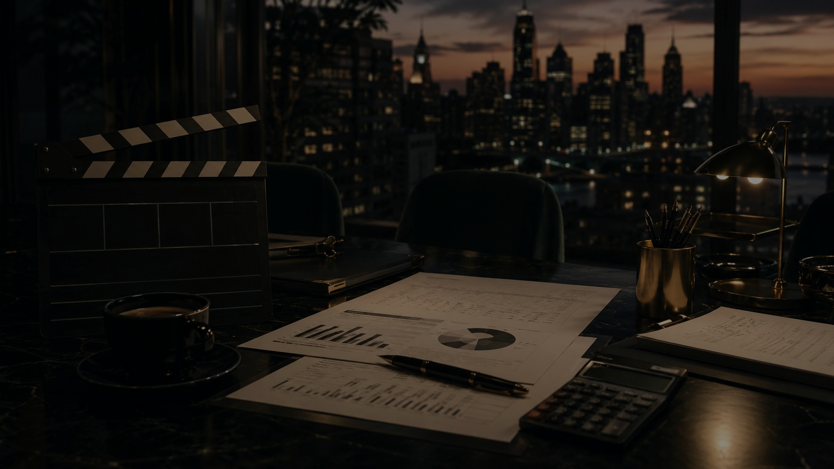
FINANCIAL VISION
One disciplined ceiling: $87,000.
The plan abandons the three-track fantasy budget and locks the deck around the money actually being raised. Lean is not cheap. Lean is choices.
Core assumptions:
Budget logic
Spend first on people and schedule. Keep physical production controlled. Protect post-production enough to finish with dignity.
- 11 contractual SAG actors
- 11-day shoot
- 12 crew at $150/day
- 3 hotel rooms
- Limited transportation
THE FREEMANS' OATH
10
Notes:
Financial vision slide frames the $87K budget ceiling as disciplined, choice-driven, and production-focused.
Accessibility note: Deck text is live/editable PowerPoint text. Body copy is designed at 16 pt or larger where practical.

Slide 15
$87,000 BUDGET TOP SHEET
The money has a job.
Top-line categories balance exactly to the $87,000 ceiling.
People: cast, crew, payroll reserve
$41,300
47.5%
Physical production and operating costs
$32,205
37.0%
Post, festival, marketing, deliverables
$9,000
10.3%
Contingency/completion reserve
$4,495
5.2%
TOTAL RAISE: $87,000
THE FREEMANS' OATH
11
Notes:
Budget top sheet summarizes the $87,000 budget by category and percentage.
Accessibility note: Deck text is live/editable PowerPoint text. Body copy is designed at 16 pt or larger where practical.

Slide 16
BUDGET DETAIL - PEOPLE
Cast, crew, and payroll reserve.
SAG actor contract pool - 11 actors
$16,000
Crew labor - 12 crew x $150 x 11 days
$19,800
Payroll/fringes/SAG processing reserve
$5,500
Note: SAG contract route, payroll fringes, pension/health, and processing fees must be verified by the producer, payroll company, counsel, and guild process before final commitment.
PEOPLE TOTAL: $41,300
THE FREEMANS' OATH
12
Notes:
People budget details include SAG actor contract pool, crew labor, and payroll reserve.
Accessibility note: Deck text is live/editable PowerPoint text. Body copy is designed at 16 pt or larger where practical.

Slide 17
BUDGET DETAIL - PRODUCTION
Equipment, wardrobe, locations, travel.
Equipment package
$4,000
Costumes, hair, and make-up
$5,000
Location rentals - minimum plan
$3,555
Transportation cap
$3,000
Lodging - 3 hotel rooms, target
$3,900
Fixed from revised brief: equipment $4,000; costumes, hair, and make-up $5,000; transportation $3,000; locations $3,555; 3 hotel rooms.
THE FREEMANS' OATH
13
Notes:
Production budget detail includes equipment, costumes/HMU, locations, transportation, and lodging.
Accessibility note: Deck text is live/editable PowerPoint text. Body copy is designed at 16 pt or larger where practical.

Slide 18
BUDGET DETAIL - FINISH LINE
Meals, permits, post, marketing, reserve.
Meals and craft services
$5,250
Insurance, legal, accounting, permits
$4,500
Production design, props, office
$3,000
Post-production finishing
$6,500
Festival, marketing, deliverables
$2,500
Contingency/completion reserve
$4,495
TOTAL BUDGET: $87,000
THE FREEMANS' OATH
14
Notes:
Final budget detail covers meals, insurance/legal/accounting/permits, production design, post, marketing, and contingency.
Accessibility note: Deck text is live/editable PowerPoint text. Body copy is designed at 16 pt or larger where practical.

Slide 19
PRODUCTION ASSUMPTIONS
How the $87K plan survives the shoot.
The math works only if the schedule behaves. The schedule behaves only if every scene, location, and actor day is locked before the first call sheet.
11 days
shoot schedule is compressed and must be locked
11 actors
contractual SAG cast pool needs clean scheduling
12 crew
$150/day for 11 days equals $19,800
3 hotel rooms
lodging depends on negotiated, limited room use
$3K transport
local hires – car services and tight moves protect the cap
$3,555 locations
locations must and will double-duty when possible
THE FREEMANS' OATH
15
Notes:
Production assumptions specify the compressed 11-day shoot, 11 SAG actors, 12 crew, three hotel rooms, transportation cap, and location rental minimum.
Accessibility note: Deck text is live/editable PowerPoint text. Body copy is designed at 16 pt or larger where practical.

Slide 20
BUDGET PROTECTION
The enemies are overtime, moves, and wishful thinking.
Schedule lock
Scene clusters, actor availability, and location order must be finalized before production begins.
Location discipline
Each location should do more than
one story job wherever possible.
In-kind offsets
Ask partners, family, and friends for rooms, locations, legal, post, food, transport, and event support.
Local-first hiring
Limit travel, hotel nights, company moves, and transportation burn.
Brutal truth: the $87K cap is realistic only if the production behaves like a clock, not a poetry reading with catering.
THE FREEMANS' OATH
16
Notes:
Risk control slide names the main budget risks and controls.
Accessibility note: Deck text is live/editable PowerPoint text. Body copy is designed at 16 pt or larger where practical.

Slide 21
REVENUE + RECOUPMENT LOGIC
Reduce cash risk before chasing upside.
The financial design combines investor capital, corporate underwriting, and in-kind offsets because the best dollar is the one that does not need to be spent twice.
Festival and event screenings
prestige, press, audience proof
Educational licensing
campus and civic learning value
Corporate civic screenings
sponsored dialogue and leadership events
Digital and broadcast sales
TVOD, AVOD, SVOD, TV where viable
Planning model only. No revenue, return, distribution, sponsor placement, or recoupment result is guaranteed. Final terms require counsel and producer review.
THE FREEMANS' OATH
17
Notes:
Revenue and recoupment slide lists possible lanes and includes a no-guarantee planning disclaimer.
Accessibility note: Deck text is live/editable PowerPoint text. Body copy is designed at 16 pt or larger where practical.

Slide 22
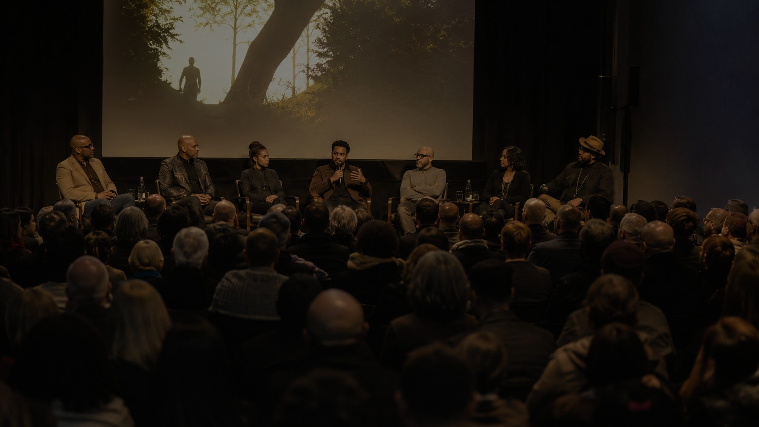
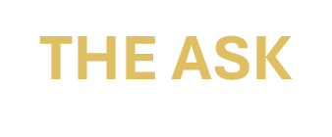
THE FREEMANS' OATH
Raise the money.
Make the oath public.
Next steps
- Confirm the $87K cap as the investor ask
- Lock SAG and line-producer assumptions
- Build partner packet around in-kind offsets
- Schedule private screening or table read
- Move from conversation to commitment
Seeking cooperate partnership:
Current outreach includes:
Dell Technologies
Taco Bell
White Castle
Wendy's
Planters
Evian
Poland Springs
8. And other anchor investor(s), corporate partners, producing partners, in-kind underwriters, and impact-tour sponsors.
Power needs witnesses.
THE FREEMANS' OATH
18
Notes:
Closing slide summarizes the ask and next steps.
Accessibility note: Deck text is live/editable PowerPoint text. Body copy is designed at 16 pt or larger where practical.

Slide 23
THE FREEMANS' OATH
Financial assumptions
$87,000 ceiling
11-day shoot
11 contractual SAG actors
12 crew at $150/day
equipment $4,000
costumes/HMU $5,000
transportation $3,000
locations $3,555
3 hotel rooms
Producer review required
SAG-AFTRA route
Fringes
Pension/health
Insurance
Permits
Securities compliance
Sponsor benefits
Recoupment terms require professional review.
THE FREEMANS' OATH
19
Notes:
Appendix states large-text accessibility choices and financial assumptions for producer review.
Accessibility note: Deck text is live/editable PowerPoint text. Body copy is designed at 16 pt or larger where practical.

Slide 24

THE FREEMANS' OATH
THE FREEMANS’ OATH –
Feature Film
I would welcome the opportunity to
discuss how you might join us as a
producing partner and help bring
THE FREEMANS’ OATH to the screen.
Contact me for budget breakdown and script.
Jeff Lambert Wingfield
www.j-wingfield.com
Wingfieldj@montclair.edu | Wingfieldjef@gmail.com
(973) 655-0154
THE FREEMANS' OATH
20
Notes:
Appendix states large-text accessibility choices and financial assumptions for producer review.
Accessibility note: Deck text is live/editable PowerPoint text. Body copy is designed at 16 pt or larger where practical.

Slide 25
Actor who have already signed onto the project,
THE FREEMANS’ OATH:
JACOB: Ethan Edward Metz Montclair State University alumni, emetz247@gmail.com
SHAKITA: Tonya Pinkins Tony Award Winner and Emmy Nominee, divinetp@gmail.com / redpillmovie2020@gmail.com
ISABELLA: Andrea Bianchi, andreabianchi39@yahoo.com
HARVEY: David Sitler, davidsitler@msn.com
JORGE: Christopher Livsey Montclair State University alumni, livluv2029@gmail.com
JORGE: Frankie C. Spears Montclair State University alumni, cfrankiespear@gmail.com
JORGE: Kato Crockett, City of Orange resident
JORGE: Joey Stellway Montclair State University alumni
RUBY: Keke Palmer https://kekepalmer.com/ via Luke Dillon ldillon@3arts.com (Solicity prospective actor for the role)
Cinematographer: Hakeem Foster, Seemecca@aol.com
Cinematographer: Monika K. Montclair State University alumni, monikakolodziej123@gmail.com
Cinematographer: Kevin Cruz, Cruzke.business@gmail.com
LIGHTING: Cariola Richards, Montclair State University alumni, City of Orange resident, Crichard.t.c.p.d@gmail.com
SOUND: Prince Bawuah, Montclair State University alumni, City of Orange resident,
COSTUME Designer: Kathleen Heron, City of Orange resident, kathleenheron@rockemail.com/kathleenheron1@gmail.com
Editor: Ronald J. Tomaino Jr. (Emmy Award winner, Green Couch Media) Montclair State University alumni, rippleproductions@hotmail.com
THE FREEMANS' OATH
21
Notes:
Appendix states large-text accessibility choices and financial assumptions for producer review.
Accessibility note: Deck text is live/editable PowerPoint text. Body copy is designed at 16 pt or larger where practical.

Slide 26
THE FREEMANS' OATH
Proposed $87,000 Budget Analysis - 11-Day Ultra-Low Budget Shoot
Prepared for producer planning | City of Orange, New Jersey | Current draft
Executive Budget Position
Target budget: $86,950.00, leaving a $50.00 cushion below the $87,000 ceiling. This version keeps all 13 SAG actors, keeps two hotel rooms, keeps one trailer, and cuts costume/hair/makeup to $3,000. The tradeoff is simple and non-negotiable: the production cannot afford all 13 SAG actors on all 11 shoot days. The cast must be scheduled at no more than 92 paid SAG actor-days total.
Budget ceiling Proposed budget Cushion SAG actor-day cap
$87,000.00 $86,950.00 $50.00 92 paid actor-days
lean post-production support. The numbers are possible, but they will not tolerate sloppy scheduling. This is a watch-the-pennies plan. The nickels are already nervous.
THE FREEMANS' OATH
22
Notes:
Cover slide introduces the large-text, ADA-friendly fundraising deck and states the $87,000 budget ceiling.
Accessibility note: Deck text is live/editable PowerPoint text. Body copy is designed at 16 pt or larger where practical.

Slide 27
Core Assumptions
- 11 shoot days in or around the City of Orange, New Jersey.
- 13 SAG principal actors retained, but scheduled in staggered blocks rather than every day.
- SAG cast estimated at the Ultra Low Budget planning floor of $249/day, plus 21% Pension & Health.
- 12 non-SAG crew budgeted at New Jersey's 2026 minimum wage floor for 8 hours per shoot day, plus a 10% employer/payroll allowance.
- No paid crew overtime, SAG meal penalties, stunt work, minors, special effects, closed streets, police detail, or major company moves are included.
- Two hotel rooms are preserved. The model assumes $125 per room night; every $10 increase in the room rate adds $220 across 11 nights.
- Costume, hair and makeup is capped at $3,000 total.
- The budget assumes aggressive use of practical locations, educational/community partnerships, discounted gear, and lean post-production support. The numbers are possible, but they will not tolerate sloppy scheduling. This is a watch-the-pennies plan. The nickels are already nervous.
THE FREEMANS' OATH
23
Notes:
Cover slide introduces the large-text, ADA-friendly fundraising deck and states the $87,000 budget ceiling.
Accessibility note: Deck text is live/editable PowerPoint text. Body copy is designed at 16 pt or larger where practical.

Slide 28
Proposed Budget Breakdown - Not to Exceed $87,000
Line Item | Formula / Basis | Amount | Control Note
SAG principal cast wages | 92 actor-days x $249/day | $22,908.00 | Keeps all 13 actors, but caps total paid call days.
SAG Pension & Health | 21% of SAG gross salary | $4,810.68 | Required planning fringe on SAG cast wages.
12 non-SAG crew wage floor | 12 crew x 11 days x 8 hrs. x $15.92/hrs. | $16,811.52 | Assumes 8-hour days and no weekly overtime.
Crew employer/payroll burden | 10% of crew wage floor | $1,681.15 | FICA/workers comp/payroll processing buffer; verify with payroll company.
Hotel rooms | 2 rooms x 11 nights x $125 | $2,750.00 | Keeps the two-room lodging commitment; rate must be production-friendly.
Trailer / base-camp holding | 1 trailer/holding unit for 11 days | $3,000.00 | Lean trailer allowance; not a luxury circus wagon.
Costume, hair and makeup | Producer cap | $3,000.00 | Reduced from $6,000 to $3,000 per instruction.
Meals and craft service | Avg. 20 heads/day x 11 days x $16 | $3,520.00 | Requires staggered cast calls; full 25 heads daily adds about $880.
Camera, G&E, sound kit | Lean package / favors / school-supported gear | $7,500.00 | Lean on owned, borrowed, donated or discounted equipment.
THE FREEMANS' OATH
24
Notes:
Cover slide introduces the large-text, ADA-friendly fundraising deck and states the $87,000 budget ceiling.
Accessibility note: Deck text is live/editable PowerPoint text. Body copy is designed at 16 pt or larger where practical.

Slide 29
Proposed Budget Breakdown - Not to Exceed $87,000
Line Item | Formula / Basis | Amount | Control Note
Production insurance | Short-form independent policy estimate | $2,800.00 | Confirm limits with SAG-AFTRA, locations and City requirements.
Locations, permits and municipal coordination | Target allowance | $2,000.00 | Only works if fees are reduced, exempt, private-location only, or negotiated.
Production design, props and set dressing | Lean allowance | $1,750.00 | Use practical locations and existing dressing.
Transportation, parking and fuel | Lean allowance | $1,750.00 | No large transportation department; avoid company moves.
Media, drives and data management | Drives/cards/backups | $1,000.00 | Do not skimp below a safe backup workflow.
Post-production allowance | Editor/color/sound/deliverables reserve | $5,500.00 | Assumes discounted or deferred post support.
Legal, accounting and payroll admin | Basic production administration | $1,750.00 | Bare-bones paperwork; not a full legal war chest.
Casting, readings and office/admin | Lean admin reserve | $750.00 | Minimal support only.
Contingency | Balance to target | $3,668.65 | Thin cushion; every extra SAG actor-day burns $301.29.
TOTAL PROPOSED BUDGET | Must not exceed $87,000 | $86,950.00 | Leaves $50.00 below the ceiling.
THE FREEMANS' OATH
25
Notes:
Cover slide introduces the large-text, ADA-friendly fundraising deck and states the $87,000 budget ceiling.
Accessibility note: Deck text is live/editable PowerPoint text. Body copy is designed at 16 pt or larger where practical.

Slide 30
SAG Cast Math and Required Actor-Day Cap
Per actor-day planning cost: $249.00 day rate + 21% Pension & Health = $301.29 per paid SAG actor-day. At 92 paid actor-days, the SAG cast total is $27,718.68. If all 13 actors worked all 11 shoot days, the production would need 143 actor-days, costing $43,084.47 for SAG cast alone. That would add $15,365.79 and push this model to $102,315.79. In plain English: everyone cannot be everywhere every day unless the budget grows. Sample 13-Actor Call-Day Allocation
Cast Slot | Paid Days | Est. SAG Cost | Scheduling Logic
Actor 1 / lead | 11 | $3,314.19 | Full shoot
Actor 2 | 10 | $3,012.90 | Near-lead
Actor 3 | 9 | $2,711.61 | Major supporting
Actor 4 | 8 | $2,410.32 | Supporting
Actor 5 | 8 | $2,410.32 | Supporting
Actor 6 | 7 | $2,109.03 | Supporting
Actor 7 | 7 | $2,109.03 | Supporting
Actor 8 | 6 | $1,807.74 | Limited arc
Actor 9 | 6 | $1,807.74 | Limited arc
Actor 10 | 5 | $1,506.45 | Block shoot
Actor 11 | 5 | $1,506.45 | Block shoot
Actor 12 | 5 | $1,506.45 | Block shoot
Actor 13 | 5 | $1,506.45 | Block shoot
THE FREEMANS' OATH
26
Notes:
Cover slide introduces the large-text, ADA-friendly fundraising deck and states the $87,000 budget ceiling.
Accessibility note: Deck text is live/editable PowerPoint text. Body copy is designed at 16 pt or larger where practical.

Slide 31
Controls Needed to Hold the Number
Lock the actor-day grid before shooting. The schedule should be built by
Character availability and scene groupings, not by convenience. Every
added SAG actor-day costs $301.29 before any meals or transportation
impact.
Treat the crew line as a wage floor, not a market-rate budget. The 12-person
crew line assumes 8-hour days and no weekly overtime. If the shoot goes
to 10- or 12-hour days, the budget will break fast.
Use private/practical locations whenever possible. City fees can materially
change the budget. If the production is treated as a full basic production
on public land for 11 days, municipal fees alone could blow the plan.
Keep hotels to the two committed rooms only. Additional rooms, higher
room rates, per diem, or travel guarantees for recognizable actors must
be separately approved before offers are made.
Do not spend the contingency early. The contingency is only $3,668.65.
That is not a cushion; that is a throw pillow. Protect it until wrap.
THE FREEMANS' OATH
26
Notes:
Cover slide introduces the large-text, ADA-friendly fundraising deck and states the $87,000 budget ceiling.
Accessibility note: Deck text is live/editable PowerPoint text. Body copy is designed at 16 pt or larger where practical.

Slide 32
City of Orange Permit Risk
Budget warning: The $2,000 location/permit allowance assumes
the production can qualify for reduced/exempt student or educational
treatment, film primarily on private locations without public-land impact,
or negotiate/limit permit exposure. Current City of Orange Township code
lists Basic Production application and permit fees, a nonprofit/student
application fee with exempt daily permit fee, a $50/day fee for each
production vehicle/trailer, and a possible escrow/bond requirement.
This must be verified directly with the City before finalizing the
schedule and cash flow.
THE FREEMANS' OATH
26
Notes:
Cover slide introduces the large-text, ADA-friendly fundraising deck and states the $87,000 budget ceiling.
Accessibility note: Deck text is live/editable PowerPoint text. Body copy is designed at 16 pt or larger where practical.

Slide 33
Fast Sensitivity Check
Change | Budget Impact | Comment
Each added SAG actor-day | +$301.29 | Reduces contingency immediately.
All 13 actors for all 11 days | +$15,365.79 | Budget would rise to $102,315.79 under this model.
Hotel rate increases by $10/night/room | +$220.00 | 22 room-nights total.
Meals cover full 25 people every day at $16 | +$880.00 | Budget assumes staggered average of 20 heads/day.
Basic City permit fee at $2,000/day for 11 days | +$22,000.00 before vehicles/bond | Not compatible with $87,000 unless offset elsewhere or exempt.
THE FREEMANS' OATH
26
Notes:
Cover slide introduces the large-text, ADA-friendly fundraising deck and states the $87,000 budget ceiling.
Accessibility note: Deck text is live/editable PowerPoint text. Body copy is designed at 16 pt or larger where practical.

Slide 34
Conclusion
A sub-$87,000 version is possible only as a
disciplined, schedule-driven ultra-low-budget plan.
The production can keep all 13 actors, the two hotel rooms,
the trailer, and the $3,000 costume/hair/makeup cap, but the
cast cannot be called broadly every day. The budget stands
or falls on a 92 actor-day ceiling, 8-hour crew days, a
practical-location strategy, and careful City of Orange
permitting. That is the production math. Not glamorous,
but neither is bankruptcy.
THE FREEMANS' OATH
26
Notes:
Cover slide introduces the large-text, ADA-friendly fundraising deck and states the $87,000 budget ceiling.
Accessibility note: Deck text is live/editable PowerPoint text. Body copy is designed at 16 pt or larger where practical.

Slide 35
Source Notes / Rate References
SAG-AFTRA Ultra Low Budget Project Agreement Rate Sheet / UPA rate references: https://www.sagaftra.org/production-center/contract/819/rate-sheet/document and
current rate sheet search result showing Day Performer $249 and 21% P&H.
New Jersey Department of Labor and Workforce Development, minimum wage
effective January 1, 2026: https://www.nj.gov/labor/lwdhome/press/2025/20251001_Minimum_Wage.shtml
New Jersey Department of Labor and Workforce Development, wage and overtime FAQs: https://www.nj.gov/labor/wageandhour/support/faqs/wageandhourworkerfaqs.shtml
City of Orange Township, NJ, Chapter 90 Film and Digital Entertainment Production:
https://ecode360.com/44502894
Planning note: This is a proposed production budget framework, not legal, union, payroll, tax, insurance, or accounting advice. Confirm all SAG-AFTRA obligations, payroll handling, location requirements, and municipal fees before issuing offers or spending funds.
THE FREEMANS' OATH
26
Notes:
Cover slide introduces the large-text, ADA-friendly fundraising deck and states the $87,000 budget ceiling.
Accessibility note: Deck text is live/editable PowerPoint text. Body copy is designed at 16 pt or larger where practical.

Slide 36
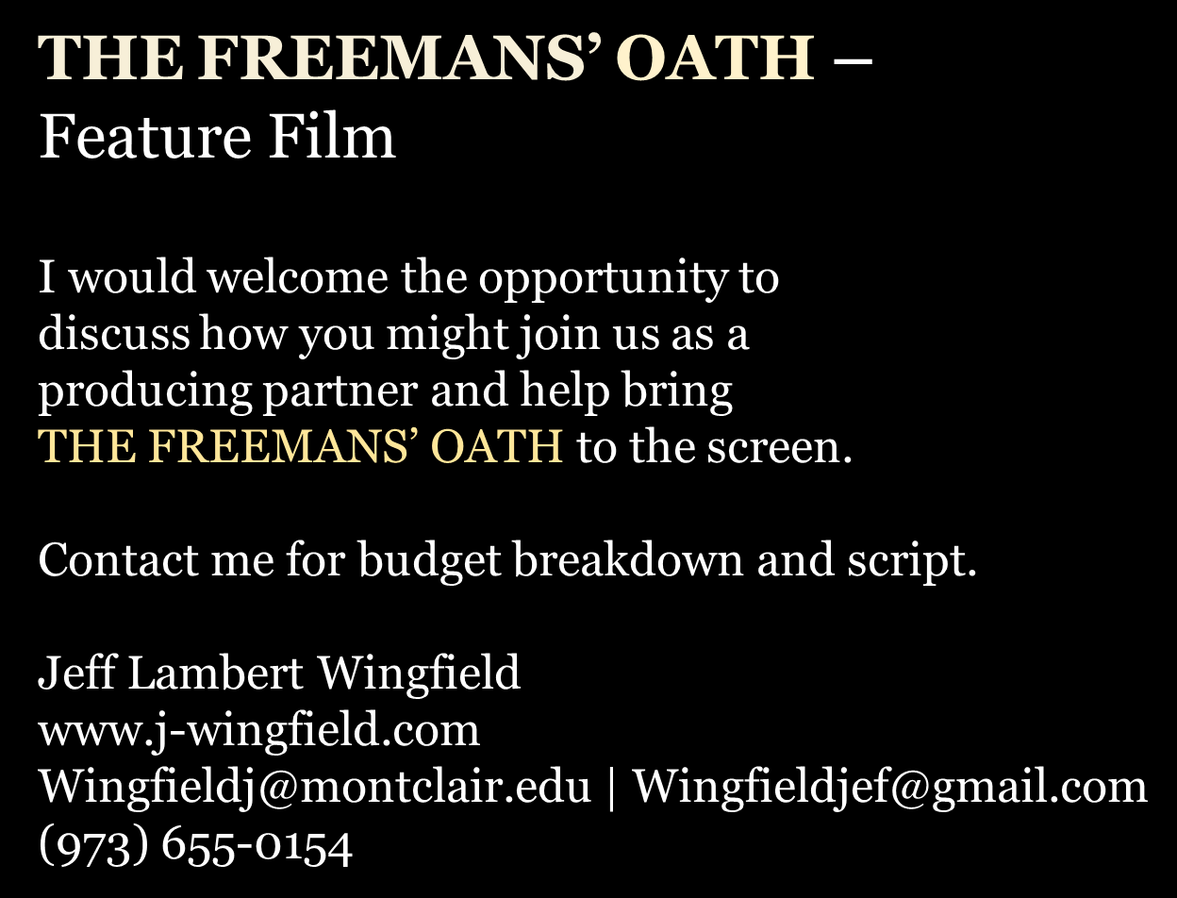
THE FREEMANS' OATH
27
Notes:
Cover slide introduces the large-text, ADA-friendly fundraising deck and states the $87,000 budget ceiling.
Accessibility note: Deck text is live/editable PowerPoint text. Body copy is designed at 16 pt or larger where practical.

